Slide 2
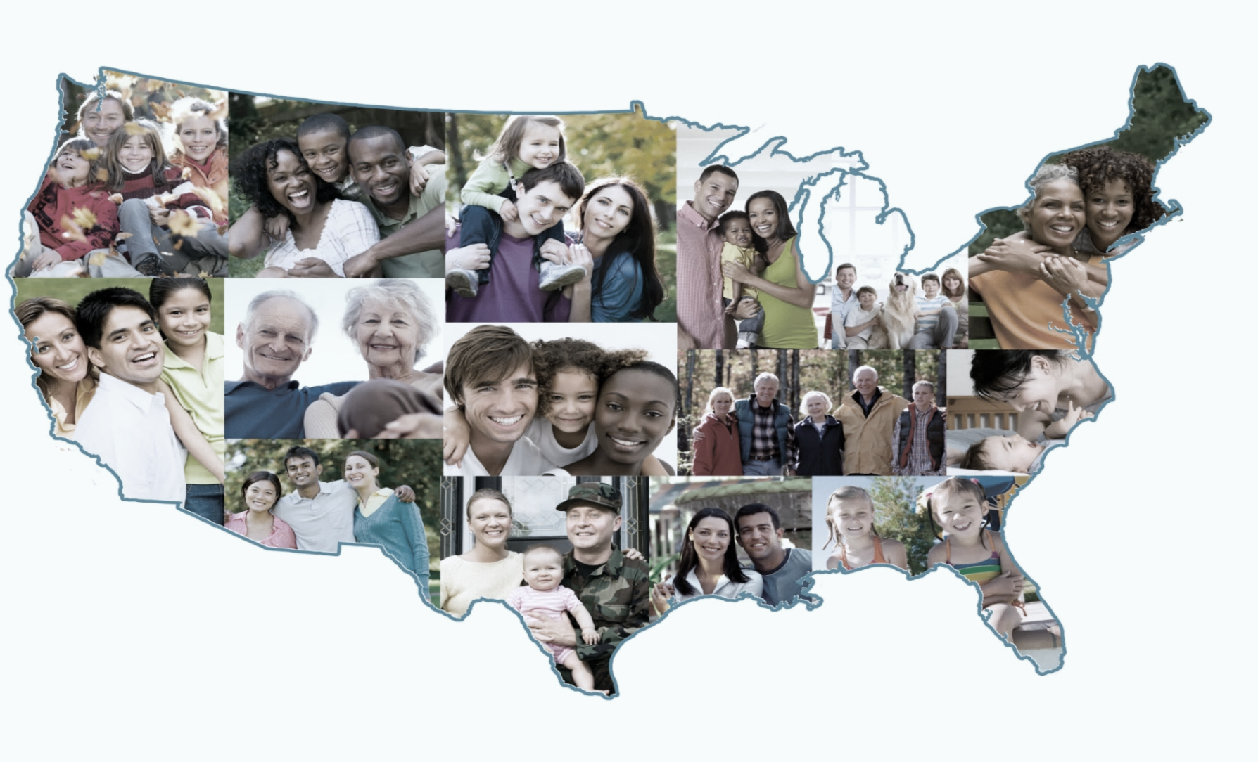
2020 CENSUS YOUR COMMUNITIES COUNT!
Atlanta Regional Office
Managing Census Operations in
AL, FL, GA, LA, MS, NC, SC
Instructors Training Guide
Notes:
Purpose: To educate potential Complete Count Committees leaders and members about the 2020 Census and their roles in the CCC’s. The goal is to equip CCC leaders with the information they need to inform their members on ways they can help promote participation in the 2020 Census. The manual that coincides with this presentation is still getting finalized. So, I don’t have the manual. But, I have copies of the power point in your folders.

Slide 3
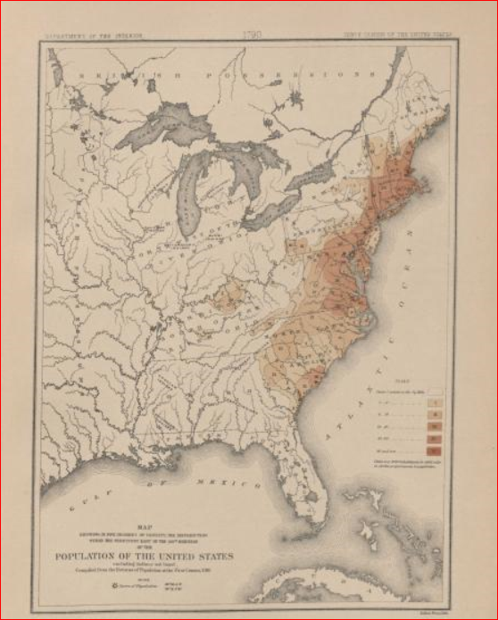
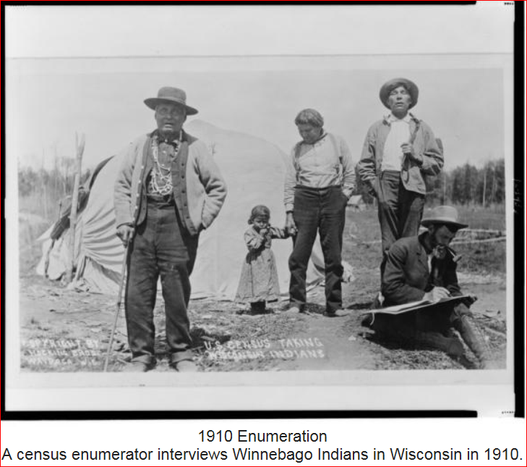
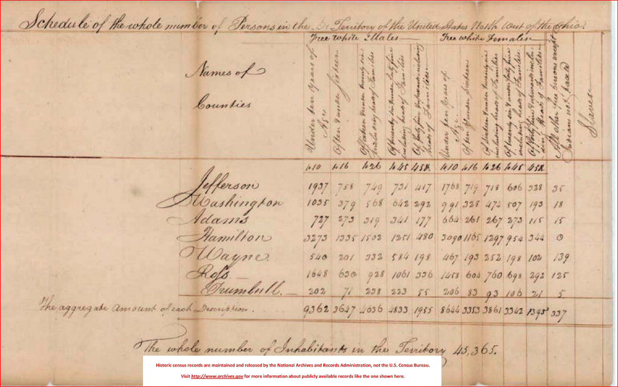
The U.S. Constitution and Decennial Census
Conducted every 10 years since 1790, as required by the U.S. Constitution. Article I, Section 2. "Representatives and direct Taxes shall be apportioned among the several States which may be included within this Union, according to their respective Numbers . . .
The 1790 counted 3.9 million inhabitants.
U.S. marshals conducted the enumerations between 1790 and 1870.
Specially trained enumerators carried out the census beginning in 1880.
Notes:
A population count is required every 10 years by the U.S. Constitution. Article 1, Section 2 states that "Representatives and direct Taxes shall be apportioned among the several States which may be included within this Union, according to their respective Numbers . . .
Note: The decennial census steadily expanded throughout the nineteenth century. And by the turn of the century, the demographic, agricultural, and economic segments of the decennial census collected information on hundreds of topics. Some households would get a long form along with the short form in order to collect that expanded demographic data. However, for the 2010 Census it was simplified back to a basic headcount with 10 questions and the other demographic topics had been removed. That demographic data is now collected in the monthly survey called the American Community Survey. The 2010 Form can be found at https://www.census.gov/2010census/about/interactive-form.php

Slide 4
Notes:
As result of the population Count in 2010, 4 states in our region experienced apportionment changes. GA and SC gained 1 Congressional seat, Florida gained 2 congressional seats, AL, NC, and MS stayed the same, while Louisiana lost one congressional.

Slide 5
Why We Ask You to Allocate Resources to the 2020 Census
Impact to Your Community
Political Representation
Census is constitutionally mandated for re-apportionment of Congress
Census results are used for Redistricting at national, state, and local levels.
Money/Economic Impact
Over $675 Billion/year is distributed to state and local governments using Census numbers (Over $4 Trillion over the decade).
Notes:
We are and have been meeting with governors, local governments, and community organizations to ask leaders to allocate resources like time and funding because the data has an economic and political impact. The reasons we asked are -Number 1, Census data is used in Congressional Apportionment every decade. The numbers are used to determine how many congressional seats are allocated to each state. I’m sure many of you have read stories or heard about certain states losing or gaining congressional seats; the decennial Census numbers determine that.
Note: If a question arises about that process, presenter may opt to “go live” or point the audience to the apportionment site at http://www.census.gov/population/apportionment/.
Number 2, decennial figures are used by states and local officials in Redistricting. The drawing of voting districts and congressional districts are heavily dictated by census data.
Note: If a question arises about that process, presenter may opt to “go live” or point the audience to the redistricting site at http://www.census.gov/rdo)
Number 3, the data is used to allocate billions of dollars in federal funds to state and local governments through federal programs and grants.

Slide 6
2020 Census Design

Slide 7
Privacy and Confidentiality
Under Title 13, U.S. Code, all Census Bureau employees swear a lifetime oath to protect respondent data. It is a felony for any Census Bureau employee to disclose any confidential census information during or after employment, and the penalty for wrongful disclosure is up to 5 years imprisonment and/or a fine of $250,000.
We protect information by taking precautions in how we collect, analyze and disseminate information. The Census Bureau has strong program to protect information as they collect, process and store it in secure IT systems.
The Census Bureau encrypts information, limits access, and actively monitors systems to make sure information stays secure.
Notes:
As a data collection agency, we must protect that information. We protect information by taking precautions in how we collect, analyze and disseminate information. The Census Bureau has a strong program to protect information as they collect, process and store it in secure IT systems.
We will never share a respondents information with others.
Read the first two (2) bullets then say the following:
In simple terms, this means
NOT IMMIGRATION, (ICE)
NOT Law Enforcement Agencies like FBI
NOT EVEN POLICE
Or allow it to be used to determine their eligibility for government benefits.

Slide 8
It is important to note that the Census Bureau:
Privacy and Confidentiality
never asks for your full Social Security number;
never asks for money or a donation;
never sends requests on behalf of a political party;
never requests PIN codes, passwords or similar access information for credit cards, banks or other financial accounts.
Notes:
It is important to note that we never ask for SS numbers, money for donations, never send requests on behalf of a political party, and we never request pin codes, passwords, or similar access information. We conduct hundreds of survey per year and in the past, some one-time surveys provided gift cards to participants for participating. In those cases, we asked for the last 4 digits of the SS number.
Note: The Interactive version of the 2010 form can be found at https://www.census.gov/2010census/about/interactive-form.php

Slide 9
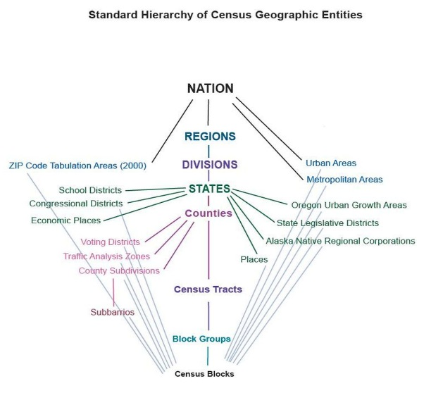
Census Bureau Collects a Wide Variety of Data Surveys
Demographics:
Age
Sex
Marital
Education
Housing
Health Ins and more
Business and Industry Data
Import/Exports
Employment
Government Data
Data at a variety of Geographic Levels:
National, State, County
City/Place
Tract
Block
Congressional Districts
Notes:
This slide shows some of the wide variety of data captured through a variety of other surveys, which you can find on the website. You can also find Census data at a variety of geographic levels and request data or a data workshop on accessing Census data if you need assistance.

Slide 10
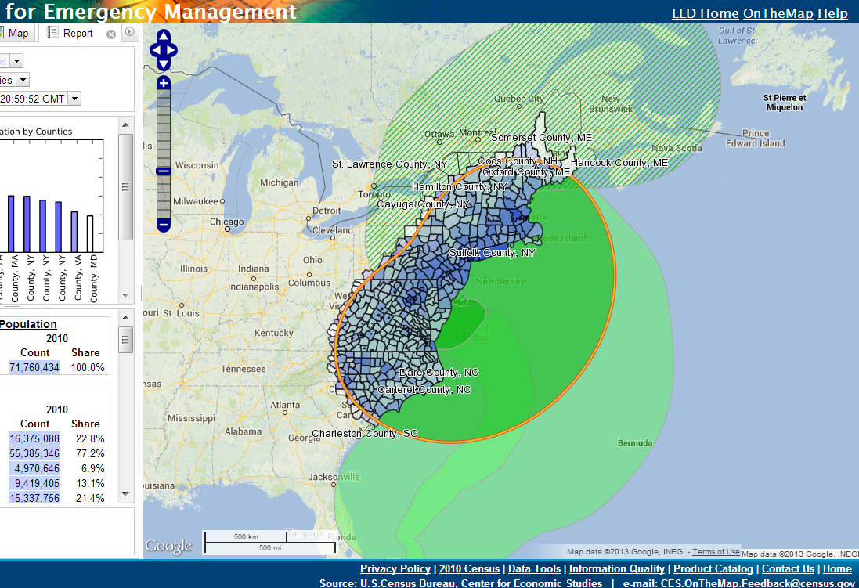
Census Data Are Used In Many Ways
Forecasting of future transportation needs
Determining areas eligible for housing assistance and rehabilitation loans
Assisting tribal, federal, state and local governments in planning, and implementing programs and services in:
Education
Healthcare
Transportation
Social Services
Emergency response
Notes:
Census data are used in many ways. Some ways include:
Review each bullet on the slide.
There is a sheet in folders. It is titled “50 Ways Census Data Are Used” for more information.
Note: The Census data includes the population data from the count and some of the more detailed socioeconomic information that is being collected monthly from a sample of the population through the American Community Survey (ACS). The ACS has been used to collect this more detailed household data nationwide since 2005. During the 2020 Census cycle, some households will receive both the ACS and the census questionnaires. Households should complete both.

Slide 11
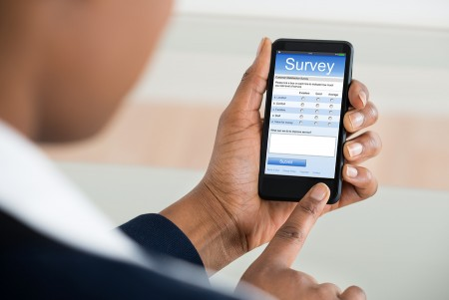
2020 Census New Initiatives
Allowing people to respond anytime, anywhere, via phone or internet. Tests have shown internet self-response is the most cost effective and accurate way. Those that request a form can complete the Census using the form.
The Census Bureau is eliminating paper and incorporating the use of handheld data collection devices.
The goal of the 2020 Census is to count everyone once,
only once and in the right place.
Notes:
In order to meet our goal to count everyone once, and only, and in the right place, the Census Bureau has implemented a couple of new initiatives for the 2020 Census. One we are Optimizing Self Response: Allowing people to respond anytime, anywhere, via phone or internet, and maximizing internet self response (testing has shown internet response is the most cost effective and the most accurate).
We are also Reengineering Field Operations:
We are eliminating paper and incorporating the use of handheld data collection devices as part of our re-engineering our field operations. In some areas, like areas with rural route addresses the Census will either send paper forms or send Census takers to those addresses.

Slide 12
2020 Census New Initiatives
The goal of the 2020 Census is to count everyone once,
only once and in the right place.
Notes:
In order to meet our goal to count everyone once, and only, and in the right place, the Census Bureau has implemented a couple of new initiatives for the 2020 Census. One we are Optimizing Self Response: Allowing people to respond anytime, anywhere, via phone or internet, and maximizing internet self response (testing has shown internet response is the most cost effective and the most accurate).
We are also Reengineering Field Operations:
We are eliminating paper and incorporating the use of handheld data collection devices as part of our re-engineering our field operations. In some areas, like areas with rural route addresses the Census will either send paper forms or send Census takers to those addresses.

Slide 13
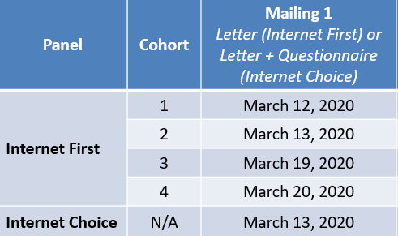
Self Response
The ISR operation was created in response to lessons learned from the 2010 Census, studies, and reviews, where it was recommended that in order to optimize self-response, the Census Bureau needed to determine the optimal contact strategies for eliciting responses to the 2020 Census and to develop an internet application for self-response that appeals to as many people as possible.
Maximizing online responses reduces the need for more expensive paper data capture and in-person follow-up.
Self-response will begin March 12, 2020 and it normally goes a couple days past the end of NRFU (July 2020).
Notes:
Internet Self Response is one of the primary ways that the Census Bureau intends to optimize self-response by allowing people to respond from any location.
Maximizing online responses reduces the need for more expensive paper data capture and in-person follow-up. The ISR operation was created in response to lessons learned from the 2010 Census, studies, and reviews, where it was recommended that in order to optimize self-response, the Census Bureau needed to determine the optimal contact strategies for eliciting responses to the 2020 Census and to develop an internet application for self-response that appeals to as many people as possible.
Self-response will begin March 12, 2020 and it normally goes a couple days past the end of NRFU.
NRFU ends on July 24 so it will probably go through the end of July.
Source:
2020 Census Detailed Operational Plan for: 12. Internet Self-Response Operation (ISR) Issued: August 22, 2018

Slide 14
Target Populations
Children 5yrs and under
Veterans
People with disabilities
Homeless
People living in rural America
Low income and underserved
Senior citizens
Migrant farm workers
Foreign Born - Immigrants
Persons with limited English proficiency
Renters
Notes:
Target Demographics are:
Historically undercounted groups. Only a sample are on the screen. We will focus on groups such as these.
This list may be familiar to you as some of the national target demographics from 2010 Decennial Census. The current efforts to enhance and refine the low response characteristics will determine the forecasted national target demographics for 2020.
Read some from the screen.

Slide 15
Geographic Partnership Programs
Accurate Census data comes from accurate geographic data, including addresses and boundaries. Local governments are the best sources for address and boundary data.
Local government participation in 2020 Geographic Partnership Programs provide opportunities to work together to ensure the best and most useful results possible.

Slide 16
2020 Census Geographic Partnerships
2020 New Construction Program
Local Update of Census Addresses (LUCA) – Partner review period March-July 2018 (120 days). Feedback to participants in August 2019.
New Construction – Program to add newly constructed housing unit addresses to Census; planned for August-November 2019.
Boundary and Annexation Survey (BAS) – Annual survey. Partner review period January-May.
Participant Statistical Areas Program (PSAP) – To edit/change tracts, block groups, and other statistical geographies for 2020 tabulations. (Review period planned for February-June 2019)
Notes:
GEOGRAPHY SLIDE
These are some key dates of the BAS program.

Slide 17
2020 New Construction Program
Non-Title 13.
Decennial program designed to capture new addresses for housing units that will be habitable on Census Day (April 1, 2020).
Address submissions will require either:
State/County/Tract/Block Geocodes or
Latitude/Longitude Coordinates
Available in Self-Response Type of Enumeration areas.
New addresses in non-Self-Response areas will be captured during field operations.
Tentatively scheduled: August-November 2019.

Slide 18
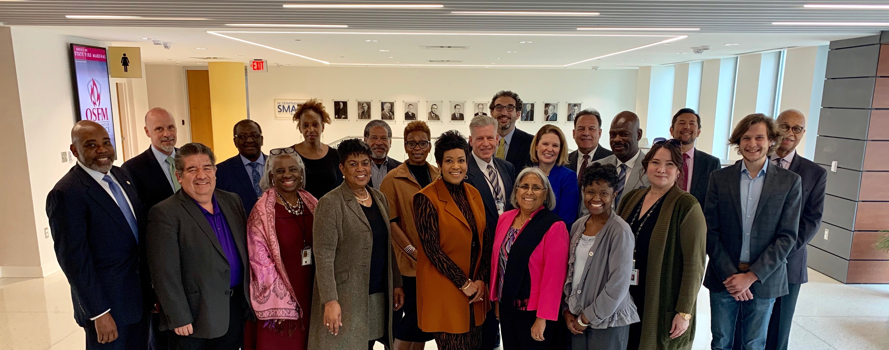
North Carolina 2020 Complete Count Commission
Created by Governor Roy Cooper, who appointed Secretary of the NC Department of Administration, Machelle Sanders to be the chairperson
Comprised of citizens, elected officials, and business leaders across all racial, ethnic and social spectrums
They meet on a monthly basis
Tasked with increasing participation in the Census statewide
The main goal is to coordinate resources and advocate efforts to accurately county those who have been historically undercounted

Slide 19
Overview of Complete Count Committees (CCCs)
Ultimately, the success of the 2020 Census depends on everyone’s participation. One way to ensure success is by forming a Complete Count Committee.
State and local governments, businesses and community leaders form Complete Count Committees to encourage participation in their community. They develop an outreach plan tailored to the unique characteristics of their community. Then they work together to implement the plan.
Their focus is to encourage individuals in their community to self respond online, on the phone or by mail (if they received a questionnaire by mail)
Notes:
Ultimately, the success of the 2020 Census depends on everyone’s participation. One way to ensure success is by forming a Complete Count Committee. Complete Count Committees encourage participation in their communities. They develop an outreach plan tailored to the unique characteristics of their community. Then they work together to implement the plan.

Slide 20
Complete Count Committees
Complete Count Committees conduct a wide range of possible activities. For example, they host promotional events, display census information in government buildings, include census messages on customer billing statements or other correspondence, and they network with community leaders to ensure everyone is involved.
Opportunity to “tailor” the Census outreach and messaging to most effectively influence local communities.
Involve all constituent groups, and use “trusted voices” of community leaders to encourage self-response.
Notes:
Complete Count Committees know the value of the census and the importance of an accurate count in their community. They also know the value of one trusted person telling another person that the census is easy, safe and important. We need you to complete the census, and we need you to tell your family, friends and neighbors to complete it too. Your community’s voice depends on it. As the 2020 Census gets closer, the Census Bureau will also launch a robust communications campaign. We’ll use advertisements, conduct outreach and provide promotional materials. You can leverage our efforts in your own community through your Complete Count Committee.
From previous Censuses, CCCs focus group sessions, and summary reports submitted by partnership specialists, the Census Bureau has compiled a listing of lessons learned from the 2010 Census and recommendations for success in the 2020 Census.
Read the bullets from the slide and say the following:
The common thread that weaves through all these different committee types and structures is that they are a team; a team charged with influencing individuals in their community to accurately respond to the 2020 Census; a team of interested and active community members who want to lead their community to a successful census campaign.
ACTIVITY: 25-30 Minutes. Refer participants to Handout: Community Identification Questions.
Divide participants into groups and provide the Community Identification Questions handout to each person. Assign a scribe and presenter. The scribe will write responses and the group will select a presenter to report their information. Give them 5 minutes per question. Be prepared to help with suggested question. Refer them to the appendix if necessary.
Ask the following questions of the participants and use their responses to further motivate discussion within their group.
Question 1: What are the demographics of your community? (Demographics include, education, income, age, gender, etc.)
Question 2: How do these demographics present a challenge to a successful census?
Question 3: What are the type of areas and/or populations are there in your community that may be a challenge to get them to participate in the census? (some of these areas are pockets of new immigrants, low income, etc.)
Question 4: How can the CCC assist the Census Bureau in getting a complete and accurate count in hard-to-count areas?
Ask Participants if there are any questions.

Slide 21
Local Government CCC’s
Local government CCC’s should include members with experience in the following areas:
Government
Education
Media
Minority Organizations
Community organizations
Workforce developments
Faith-based institutions
Businesses
Notes:
Regardless of the structure, local government committees should include members with experience in the following areas: Read the bullets on the slide and then say the following:
Tribal and local governments CCCs are a group of leaders and members appointed by the highest elected official for the purpose of developing and implementing a census awareness campaign designed to motivate EVERY one in EVERY household to participate in the 2020 Census by completing the questionnaire accurately in a timely manner.
Activity: Ask participants if they can think of any additional strategies or activities that can be implemented by a tribal or local government CCC.
Allow a brief discussion with the group and highlight recommendations offered by the group.
NOTE: Workforce development means recruiting for census jobs.

Slide 22
Community-based CCC’s
The Census Bureau encourages community leaders in hard-to-count areas to form CCC’s and include trusted voices from the community.
Hard-to-count areas may, for example, have:
• Children 5yrs old and under
Hidden or overcrowded housing
• Populations that speak little or no English
• Off-campus apartments
• New immigrant populations
• High poverty areas
• People displaced by natural disasters such as floods, fires, and hurricanes
Notes:
Still on page 8 in their Training Manual.
Read the bullets on the slide and then say the following:
Community CCCs are usually formed in specific low response score areas in communities and populations.
Grassroots community organizing efforts are needed to reach populations that have not responded well in previous censuses, or that may be historically undercounted in the census.
The community leader or group of interested participants selects a chairperson and subcommittee chairpersons. The size of this committee will be determined by its members. Hard-to-count areas may, for example, have: • Hidden or overcrowded housing. • Populations that speak little or no English. • Off-campus apartments. • New immigrant populations. • People displaced by natural disasters such as floods, fires, and hurricanes • Housing with restricted access, like gated communities or areas where migrant and/or seasonal workers live. One of the principal benefits of the CCC program is the synergistic effect of a community working together to spread the word about the importance of the census and value of participating/being counted in the census process.

Slide 23
Get Organized Right NOW!
Households will begin to experience, by the summer of 2019, some type of census operation such as address listing. These necessary operations verify the accuracy and location of each address.
The immediate formulation of a CCC will ensure that local households are kept abreast of the various census operations before the information is nationally circulated.
The more informed households are about the 2020 Census operations, the better their understanding of the census process becomes, thus increasing their willingness to be a part of the successful enumeration in 2020.
Notes:
We are asking CCC’s to start organizing now. The reason is that households will begin to experience, by the summer of 2019, some type of census operation such as address listing. These necessary operations verify the accuracy and location of each address.
The immediate formulation of a CCC will ensure that local households are kept abreast of the various census operations before the information is nationally circulated.
The more informed households are about the 2020 Census operations, the better their understanding of the census process becomes, thus increasing their willingness to be a part of the successful enumeration in 2020.

Slide 24
Prepare for 2020 Census, Now!
Host or join a Complete Count Committee and partner with other trusted voices and influential leaders in your area who are committed to increasing census participation. Allocate funding for this public education and outreach campaign.
Raise awareness by including census information in speeches, newsletters, social media posts, podcasts, email blast, utility bills, bulletin boards, signs, bill boards, mailings, and add census links on web sites.
Issue a proclamation announcing your CCC signaling the start of the public education and outreach campaign.
U. S. Census Bureau will have a national education. marketing and advertising campaign.
Help recruit census workers when jobs become available.
Notes:
This is what we have been telling elected officials and everyone else we have met with. The actual count is in 2020, but the census is here.
By forming CCC’s now, you can begin developing your plan, allocating your resources and informing your community.
o A good first step is identifying your community’s unique characteristics. Consider any barriers or concerns that may prevent your community members from participating in the census. Then you can explore ways to address or overcome those barriers.
o You can begin allocating funds for conducting outreach activities through 2020.
o In 2018, residents may begin to see census workers verifying our address list in your community. The more informed your residents are about the 2020 Census, the better they will understand the process and the more willing they will be to participate.
• If you are interested in forming a Complete Count Committee, contact the Census Bureau regional office covering your area. You can find your regional office at https://www.census.gov/about/contact-us/regions.html.
We will support you.
Local staff will also be available to work with Complete Count Committees at the county and municipal levels.
• We will provide information, assist you in forming committees and subcommittees, and participate in local events and activities.

Slide 25
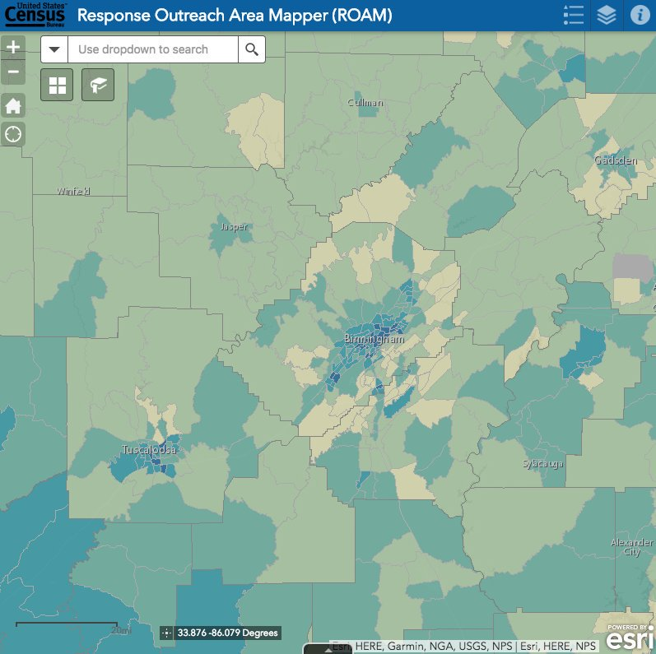
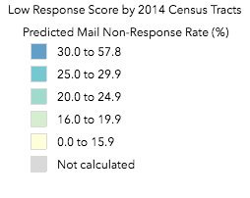
Explore the Response Outreach Area Mapper Web Application https://www.census.gov/roam
The U.S. Census Bureau has released the Response Outreach Area Mapper (ROAM) web application.
An interactive map to identify areas that typically have low response rates for censuses and surveys.
Community planners and local officials can use the ROAM to plan, focus and allocate resources for the 2020 Census.
Provides tract-level data.
Notes:
The Census Bureau also created the Response Outreach Area Mapper (ROAM) application or ROAM. The ROAM is an interactive web mapping application that allows users to easily access LRS at tract level and select variables from the Planning Database. This tools is available to the public and we use it for our outreach efforts.
The ROAM can help you:
Identify hard-to-count areas (areas with concentrations of hard-to-count populations that make counting them or enumeration of the area difficult).
Identify areas where special outreach and promotion efforts should be considered, such as areas with language barriers, high poverty levels, or where residents have displaced due to natural disasters.
It was developed to make it easier to identify hard-to-survey areas and to provide a socioeconomic and demographic characteristic profile of these areas using American Community Survey (ACS) estimates available in the Planning Database. Learning about each hard-to-survey area allows the U.S. Census Bureau to create a tailored communication and partnership campaign, and to plan for field resources including hiring staff with language skills. These and other efforts can improve response rates.

Slide 26
How the Census Bureau Will Support You?
We will provide staff from our regional offices to work directly with each Complete Count Committee.
We will provide information, assist you in forming committees and subcommittees, and participate in local events and activities.
We will provide a guide for 2020 Census Complete Count Committees. In the meantime, you can refer to a Complete Count Committee guide and other information available online from the 2010 Census for historical reference. Keep a big change in mind though: we’ll primarily ask people to respond to the 2020 Census online (not by mail).
As the 2020 Census gets closer, the Census Bureau will also launch a robust communications campaign. We’ll use advertisements, conduct outreach. You can leverage our efforts in your own community through your Complete Count Committee.
Notes:
The census Bureau will provide staff from our regional offices to work directly with each Complete Count Committee. As the 2020 Census gets closer, the Census Bureau will also launch a robust communications campaign. We know how important it is for you to have materials that help spread the word in your community. We plan to provide a variety of digital resources. If budget allows, we may also provide a limited quantity of printed materials and promotional items.
We are currently researching the best messages to use, the best types of materials and the best campaign design.
We plan to provide an array of digital assets like logos, taglines, drop-in articles and template fact sheets and posters for you to customize and share with your community.
If you have any feedback about what worked well last time or what improvements you suggest for the 2020 Census, I’d be happy to hear those and pass that feedback along to the team developing these plans.

Slide 28
Contact Information
Atlanta Partnership Staff – Field Division – North Carolina atlanta.rcc.partnership@census.gov
Atlanta Geography 470-889-6550 atlanta.geography@census.gov
Kenneth C. Wilkins, Partnership Specialist - 678-733-2569
kenneth.c.wilkins@2020census.gov
CENSUS BUREAU IS CURRENTLY RECRUITING!
Atlanta Recruiting - Toll Free Jobs Line 1-855-JOB-2020 / (1-855-562-2020)
www.usajobs.gov or Census.gov/fieldjobs Hourly Jobs - 2020census.gov/jobs

